Slide 1
CSM 61A
Midterm 2 Review
Tree Recursion
Trees
Nonlocal & Orders of Growth
Object Oriented Programming
Linked Lists
March 16th, 2019
Notes:
Remember to ask students on Piazza to vote for which topic they want to be covered the most → do the ordering of the topics associated with most popular to least popular.

Slide 2
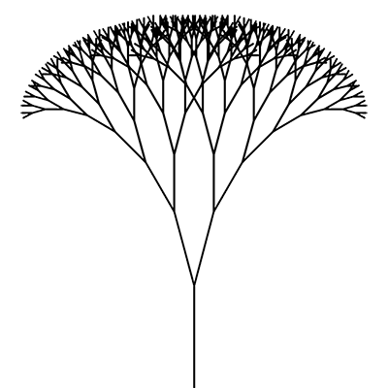
TREE RECURSION

Slide 3
Recursion Review:
Base case: The smallest or most trivial input; this should be an input for which you immediately know the answer
Recursive case:
Recursive leap of faith / reduction - we can assume our function works for any input k < n; the tricky part is deciding what value(s) for k to use!
Solving - how can we use a reduction to solve our original problem?
Notes:
Although we’ve separated the recursive case into two steps, they likely will form in parallel, rather than sequentially. The “reduction” is what we’ve been frequently calling the “subproblem” / “subsolution.” Because of the recursive leap of faith, you can usually solve the base and recursive cases independently!

Slide 4
Tips for Recursion Problems:
Identify what your base case is and create recursive calls to get you “closer” to your base case. (You don’t always need to define base cases first. You may define them as you make recursive calls)
Which variables do you want to change every recursive call?
Last line doesn’t have to be a recursive call
Make sure your function always returns the same data types
○(e.g you can’t return True in a base case and 1 in another case)

Slide 5

Tree Recursion Analogy
Suppose you are the CEO of McDonalds, and you would like to know how many employees there are in US. What should you do?

Slide 6
Tree Recursion Analogy
CEO
?
?
?
?
WA
CA
…………………….
TX
NY
You can simply ask each employee in charge of each state. However, it turns each of them doesn’t know the number of employees in each state either.

Slide 7
Tree Recursion Analogy
CEO
WA
CA
TX
NY
…………………….
Such asking keeps going until it reaches an individual employee at a local store (e.g. Berkeley McDonalds). Since there are no more employees below. The employee informs the supervisor that there has to be at least 1 employee (Base Case), counting him/herself as 1.
Alameda
Berkeley
employee

Slide 8
Tree Recursion Analogy
CEO
WA
CA
TX
NY
…………………….
Now that an employee in charge of a local store knows the number of employees in the store, he/she informs an employee in charge of a county that there are x employees in the store.
Each employee in charge of each city informs each employee in charge of each county, and so on.
Alameda
Berkeley
employee

Slide 9
Tree Recursion Analogy
CEO
WA
CA
TX
NY
…………………….
After each employee in charge of each state informs you about the number of employees in each state. Now you know how many employees there are in US. It was possible because each employee trusted that an employee below him/her knows the number of employees.
Alameda
Berkeley
employee

Slide 10
Tree Recursion Analogy
Such belief is fundamental in recursion/tree recursion. Treat each employee as each recursive call. You must trust that each recursive call would work.

Slide 11
Tips for Tree Recursion
Recursion, but with multiple recursive call!
Sometimes necessary to use helper functions when you need to keep track of more variables than you are given
Typically have a “choice”: do one action or the other
○Need to look at all possible combinations
Helps to draw out the function calls.

Slide 12
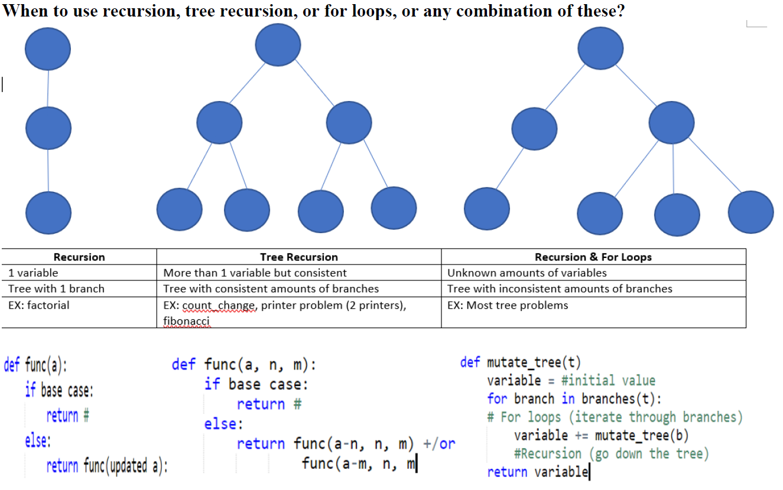

Slide 13
Disjoint Subproblems
Single-call recursion requires expression in terms of a single subproblem
“Tree” recursion requires expression in terms of multiple disjoint subproblems
Introduces two new types of problems
Optimization: What is the best choice of multiple possible choices? (min/max)
Counting - How many ways are there of doing something?
Notes:
Note: that’s not to say previously-seen styles of problems don’t exist anymore! But these types will typically always require multiple recursive calls.

Slide 14
Counting
Rule of sum
If there are are x ways of doing one thing and y ways of doing another disjoint thing, there are x + y ways of doing either thing
e.g. If there are 5 Trader Joe’s, 3 Safeways, and 4 Whole Foods in Berkeley (and no other stores), there are 5 + 3 + 4 = 12 ways of getting groceries in Berkeley.

Slide 15
Counting
Rule of product
If there are are x ways of doing one thing and y ways of doing another thing, there are xy ways of doing both things
e.g. If I only have 3 shirts, 4 pants, and 5 hats, I can wear 3 x 4 x 5 = 60 possible outfits today.
e.g. If I have 2 blue shirts, 4 blue pants, 6 red shirts, and 3 red pants, I can wear 2 x 4 + 6 x 3 = 8 + 18 = 26 monochromatic outfits today

Slide 16
Problem 1: Your Father’s Parentheses
Suppose we have a sequence of quantities that we want to multiply together, but can only multiply two at a time.
We can express the various ways of doing so by counting the number of different ways to parenthesize the sequence.
Define a function count_groupings(n) that returns the number of ways parenthesizing the product of n numbers, where n > 0.
Source: Mt1, Spring 2016

Slide 17
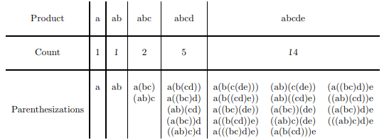
Problem 1: Your Father’s Parentheses
For example, here are the possibilities for products of 1, 2, 3, 4 and 5 elements:

Slide 18
Problem 1: Your Father’s Parentheses
def count_groupings(n):
if n == 1:
return ____________________________________
______________________________________________
for __________________________________________
__________________________________________
return _______________________________________

Slide 19
Problem 1: Your Father’s Parentheses
def count_groupings(n):
if n == 1:
return 0___________________________________
total = 0_____________________________________
for i in range(n)_____________________________
total += count_groupings(i) * count_groupings(n - i)
return total__________________________________

Slide 20
Problem 1: Your Father’s Parentheses
def count_groupings(n):
if n == 1:
return 0___________________________________
total = 0_____________________________________
for i in range(n // 2)________________________
total += 2 * (count_groupings(i) * count_groupings(n - i))
return total__________________________________

Slide 21
Problem 2: Edit Distance
Suppose we have two strings. We can align the characters of the two strings in different ways; call the cost of an alignment the number of positions where characters differ.
The Levenshtein edit distance is the minimum cost of aligning two strings.
For example, the best alignment for “dapple” and “grape” is
with an edit distance of 4.
_dapple
grap__e

Slide 22
Problem 2: Edit Distance
Assume you are given a function diff(c1, c2) that takes in 2 single-character strings and returns
1 if c1 == c2
0 otherwise
def edit_distance(s1, s2):
if ___________________________________________:
return ___________________________________
elif _________________________________________:
return ___________________________________
else:
___________________________________________
___________________________________________
___________________________________________
return ____________________________________

Slide 23
Problem 2: Edit Distance
def edit_distance(s1, s2):
if len(s1) == 0_______________________________:
return len(s2)_____________________________
elif len(s2) == 0_____________________________:
return len(s1)_____________________________
else:
___________________________________________
___________________________________________
___________________________________________
return ____________________________________

Slide 24
Problem 2: Edit Distance
def edit_distance(s1, s2):
if len(s1) == 0_______________________________:
return len(s2)_____________________________
elif len(s2) == 0_____________________________:
return len(s1)_____________________________
else:
a = edit_distance(s1[1:], s2)______________
b = edit_distance(s1, s2[1:])______________
c = edit_distance(s1[1:], s2[1:])__________
return ____________________________________

Slide 25
Problem 2: Edit Distance
def edit_distance(s1, s2):
if len(s1) == 0_______________________________:
return len(s2)_____________________________
elif len(s2) == 0_____________________________:
return len(s1)_____________________________
else:
a = edit_distance(s1[1:], s2)______________
b = edit_distance(s1, s2[1:])______________
c = edit_distance(s1[1:], s2[1:])__________
return min(a + 1, b + 1, c + diff(s1[0], s2[0]))

Slide 26

Problem 1: Deck of Cards
Given a deck of cards, you may choose either the top or the bottom card. Each card contains an integer value. When you choose the top card, the bottom card is discarded. When you choose the bottom card, the top card is discarded. Each time you choose a card, you add the value to the total. Your goal is to end up with the highest total. Repeat this process until you run out of cards.
Return the total that results from the best strategy.

Slide 27
Deck of Cards
def DC(d):
*DC takes in a list d, which represents a deck of cards
*You may use more lines than provided.
>>DC([-1, 4, 5])
9 (because 5+4 = 9)
>>DC([-1, 4, 5, -7])
4 (because -1 + 5 = 4)
>>DC([])
0
________________________________________________________
_________________________________________________
__________________________________________
__________________________________________________
___________________________________________
_________________________________________________________

Slide 28
Deck of Cards
def DC(d):
*DC takes in a list d, which represents a deck of cards.
*You may use more lines than provided.
>>DC([-1, 4, 5])
9 (because 5+4 = 9)
>>DC([-1, 4, 5, -7])
4 (because -1 + 5 = 4)
def helper(d, total):
______________________________________
________________________________
______________________________________
________________________________
return helper(d, 0)
HINT
lst[-1] returns the last element of the list
lst[:-1] returns every elements of the list except the last element

Slide 29
Deck of Cards
def DC(d):
*DC takes in a list d, which represents a deck of cards
>>DC([-1, 4, 5])
9 (because 5+4 = 9)
>>DC([-1, 4, 5, -7])
4 (because -1 + 5 = 4)
def helper(d, total):
If (not d):
return total
else:
return max(helper(d[1:-1], total + d[0]),
helper(d[1:-1], total+ d[-1]))
return helper(d, 0)

Slide 30
Deck of Cards
For this kind of question, it is difficult to test your code on large examples (e.g. 52 cards). However, if your code works on small examples that consider all cases(e.g. even or odd number of cards), you can trust that it would work for large examples. Such belief is necessary especially when implementing a tree recursive problem.

Slide 31

TREES

Slide 32
TREE Facts
Botany
All trees have a label and branches
Branches are also trees (what does this imply about the way we should solve tree problems? Use recursion)
Trees without branches are leaves.
Nodes mark out individual points in a tree structure:
1
2
3
4
5
Quick Exercise: Find all trees!
1

Slide 33
Example Implementations
Functions
tree(label, branches): constructs a tree
is_leaf(tree)
branches(tree)
label(tree)
OOP: defined in terms of objects
t = Tree(label, branches): constructs a tree as an object
t.is_leaf()
t.branches()
t.label
Mutable
Dot notation

Slide 34

Typical way to solve tree problems
Process the leaf (Base Case!)
if is_leaf(t): …
Recurse on all the branches
[... for b in branches(t) if …]
for b in branches(t): …
We sometimes skip processing the leaf, because base case may be handled in our recursive call. More on that later!
Tree Checklist:
Leaves
Branches
Label/Root
3
1
Leap of Faith Zone
2
3
4
5
1, 2

Slide 35
Problem 1: Eval Trees (functions)
def eval_tree(t):
if __________________________:
________________________
________ = _________________
if __________________________:
__________________________
else:
__________________________
Question: When given a tree t, evaluate the tree with functions at non-leaf nodes (either a + or *) and numbers at each leaves. Assume that functions sum and prod exist.
*
+
3
1
2

Slide 36
Problem 1: Eval Trees (Using functions)
def eval_tree(t):
if __________________________:
________________________
________ = _________________
if __________________________:
__________________________
else:
__________________________
Question: When given a tree t, evaluate the tree with functions at non-leaf nodes (either a + or *) and numbers at each leaves. Assume that functions sum and prod exist.
*
1 + 2 = 3
+
3
1
2

Slide 37
Problem 1: Eval Trees (Using functions)
def eval_tree(t):
if __________________________:
________________________
________ = _________________
if __________________________:
__________________________
else:
__________________________
Question: When given a tree t, evaluate the tree with functions at non-leaf nodes (either a + or *) and numbers at each leaves. Assume that functions sum and prod exist.
*
3 X 3 = 9
3
3

Slide 38
Problem 1: Eval Trees (Using functions)
def eval_tree(t):
if __________________________:
________________________
________ = _________________
if __________________________:
__________________________
else:
__________________________
Question: When given a tree t, evaluate the tree with functions at non-leaf nodes (either a + or *) and numbers at each leaves. Assume that functions sum and prod exist.
*
(1 + 2) X 3 = 9
+
3
1
2

Slide 39
Problem 1: Eval Trees
Tree Checklist:
Leaves
Branches
Label/Root
def eval_tree(t):
if __________________________:
________________________
________ = _________________
if __________________________:
__________________________
else:
__________________________
Hints:
If the tree is a leaf, what should you return? (Hint hint: what are at the leaf nodes?)
We are asked to use sum and prod. When do we sum nodes up and when do we prod sums up? (Hint hint: non-leaf nodes)
What are ways to recurse in tree? And which one should we use here?

Slide 40
Problem 1 Solutions
Tree Checklist:
Leaves
Branches
Label/Root
def eval_tree(t):
if __________________________:
________________________
________ = _________________
if __________________________:
__________________________
else:
__________________________
We should check the leaf as the base case!

Slide 41
Problem 1 Solutions
Tree Checklist:
Leaves
Branches
Label/Root
def eval_tree(t):
if is_leaf(t):
________________________
________ = _________________
if __________________________:
__________________________
else:
__________________________
We should check the leaf as the base case!

Slide 42
Problem 1 Solutions
Tree Checklist:
Leaves
Branches
Label/Root
def eval_tree(t):
if is_leaf(t):
________________________
________ = _________________
if __________________________:
__________________________
else:
__________________________
First, we should check the leaf as the base case!
Second, if the tree is indeed a leaf…
1
we return 1 or the value of the leaf node!

Slide 43
Problem 1 Solutions
Tree Checklist:
Leaves
Branches
Label/Root
def eval_tree(t):
if is_leaf(t):
return label(t)
________ = _________________
if __________________________:
__________________________
else:
__________________________
First, we should check the leaf as the base case!
Second, if the tree is indeed a leaf…
1
we return 1 or the value of the leaf node!

Slide 44
Problem 1 Solutions
Tree Checklist:
Leaves
Branches
Label/Root
def eval_tree(t):
if is_leaf(t):
return label(t)
________ = _________________
if __________________________:
__________________________
else:
__________________________
Next, we look at what we want to do to the branches.
This is where our recursive call comes in.
*
*
+
3
3
3
1
2
9

Slide 45
Problem 1 Solutions
Tree Checklist:
Leaves
Branches
Label/Root
def eval_tree(t):
if is_leaf(t):
return label(t)
children = [... for b in branches(t)]
if __________________________:
__________________________
else:
__________________________
Next, we look at what we want to do to the branches.
This is where our recursive call comes in.
*
*
+
3
3
3
1
2
9

Slide 46
Problem 1 Solutions
Tree Checklist:
Leaves
Branches
Label/Root
def eval_tree(t):
if is_leaf(t):
return label(t)
children = [eval_tree(b) for b in branches(t)]
if __________________________:
__________________________
else:
__________________________
Next, we look at what we want to do to the branches.
This is where our recursive call comes in.
*
*
+
3
3
3
1
2
9

Slide 47
Problem 1 Solutions
Tree Checklist:
Leaves
Branches
Label/Root
def eval_tree(t):
if is_leaf(t):
return label(t)
children = [eval_tree(b) for b in branches(t)]
if __________________________:
__________________________
else:
__________________________
Last, we look at the label / non-leaf nodes of eval_tree.
What do they signify?
>>> They tell us which operator to use
And how?
>>> If “+”, we sum. Otherwise, we prod.

Slide 48
Problem 1 Solutions
Tree Checklist:
Leaves
Branches
Label/Root
def eval_tree(t):
if is_leaf(t):
return label(t)
children = [eval_tree(b) for b in branches(t)]
if label(t) == “+”:
return sum(...)
else:
return prod(...)
Last, we look at the label / non-leaf nodes of eval_tree.
What do they signify?
>>> They tell us which operator to use
And how?
>>> If “+”, we sum. Otherwise, we prod.

Slide 49
Problem 1 Solutions
Tree Checklist:
Leaves
Branches
Label/Root
def eval_tree(t):
if is_leaf(t):
return label(t)
children = [eval_tree(b) for b in branches(t)]
if label(t) == “+”:
return sum(...)
else:
return prod(...)
Last, we look at the label / non-leaf nodes of eval_tree.
What do they signify?
>>> They tell us which operator to use
And how?
>>> If “+”, we sum. Otherwise, we prod.
And what do we do these operations over?
>>> CHILDREN!

Slide 50
Problem 1 Solutions
Tree Checklist:
Leaves
Branches
Label/Root
def eval_tree(t):
if is_leaf(t):
return label(t)
children = [eval_tree(b) for b in branches(t)]
if label(t) == “+”:
return sum(children)
else: # This is same as label == “*”
return prod(children)
Last, we look at the label / non-leaf nodes of eval_tree.
What do they signify?
>>> They tell us which operator to use
And how?
>>> If “+”, we sum. Otherwise, we prod.
And what do we do these operations over?
>>> CHILDREN!

Slide 51
Problem 2 - Least_Tree
7
2
When given a tree t, return a new tree where, for each tree within t, the label of the root node is the smallest label among all of the node’s subtrees and the node itself.
5
3
2
3
4
2
4
2
def least_tree(t):
if __________________________:
________________________________
else:
return _______________________________________
Adapted from Albert Wu’s max_tree problem
Albertwu.org :)

Slide 52
Problem 2 - Problem Info
Code Structure:
def least_tree(t):
if ______________:
__________________
else:
return __________________
Domain: Tree t (potentially with branches)
Range: A new tree
Every label is the smallest in its subtree
Root is the smallest label in the tree
Mutation? - No
Code structure seems recursive…..so we need to examine:
Base Case
Recursive case(s)
Adapted from Albert Wu’s max_tree problem
Albertwu.org :)

Slide 53
Problem 2 - Getting Started
Base Case: simplest possible input
t is a leaf
Output:
Tree Checklist:
Leaves
Branches
Label/Root
2
least_tree(t)
2
def least_tree(t):
if __________________________:
________________________________
else:
return _______new Tree(?, ?)__________
Adapted from Albert Wu’s max_tree problem
Albertwu.org :)

Slide 54
Problem 2 - Getting Started
What should we do if t is a leaf?
Hint 1: what kind of variable does our function output?
Hint 2: what is the difference between the input and output trees if t is a leaf?
Output:
Tree Checklist:
Leaves
Branches
Label/Root
2
least_tree(t)
2
def least_tree(t):
if t.is_leaf()::
________________________________
else:
return _________new Tree(?, ?)_______________
Adapted from Albert Wu’s max_tree problem
Albertwu.org :)

Slide 55
Problem 2 - Getting Started
What should we do if t is a leaf?
Return a new tree!
This tree is exactly the same as the input leaf
Output:
Tree Checklist:
Leaves
Branches
Label/Root
2
least_tree(t)
2
def least_tree(t):
if t.is_leaf():
return Tree(t.label)
else:
return ________new Tree(?, ?)_______________
Adapted from Albert Wu’s max_tree problem
Albertwu.org :)

Slide 56
Problem 2 - Treecursion
Let’s take a look at the branches of t:
Tree fact: Branches are also trees
We can treat each branch as its own subtree
Each branch must also follow the rules of a least_tree
Do we have a function that returns a subtree that follows the least_tree rules?
Tree Checklist:
Leaves
Branches
Label/Root
def least_tree(t):
if t.is_leaf():
return Tree(t.label)
else:
return _________new Tree(?, ?)____________
Adapted from Albert Wu’s max_tree problem
Albertwu.org :)

Slide 57
Problem 2 - Treecursion
We only have one line left, but two checklist items to complete!
Write our own code first
Split up the branches and the root case
Consider the branches case first
Tree Checklist:
Leaves
Branches
Label/Root
def least_tree(t):
if t.is_leaf():
return Tree(t.label)
else:
least_branches = [least_tree(b) for b in t.branches]
least_label = _________________________________
return _________new Tree(?, ?)_______________
Adapted from Albert Wu’s max_tree problem
Albertwu.org :)

Slide 58
Problem 2 - Treecursion
Want each subtree in output tree to follow the least_tree pattern
Call least_tree on each branch
Common to use a list comprehension - list of branches
Tree Checklist:
Leaves
Branches
Label/Root
def least_tree(t):
if t.is_leaf():
return Tree(t.label)
else:
least_branches = [least_tree(b) for b in t.branches]
least_label = _________________________________
return _________new Tree(?, ?)_______________
Adapted from Albert Wu’s max_tree problem
Albertwu.org :)

Slide 59
Problem 2 - Labelling our Tree
Want our root node’s label to be the smallest value in the tree
Two options:
Smallest label out of the root nodes in the branches
The root node already has the smallest label
Tree Checklist:
Leaves
Branches
Label/Root
def least_tree(t):
if t.is_leaf():
return Tree(t.label)
else:
least_branches = [least_tree(b) for b in t.branches]
least_label = _________________________________
return _________new Tree(?, ?)_______________
Adapted from Albert Wu’s max_tree problem
Albertwu.org :)

Slide 60
Problem 2 - Labelling our Tree
Want our root nodes’ label to be the smallest value in the tree
Two options:
Smallest label out of the root nodes in the branches
The root node already has the smallest label
Tree Checklist:
Leaves
Branches
Label/Root
def least_tree(t):
if t.is_leaf():
return Tree(t.label)
else:
least_branches = [least_tree(b) for b in t.branches]
least_label = min([t.label + [lb.label for lb in least_branches])
return new Tree(least_label, least_branches)
Adapted from Albert Wu’s max_tree problem
Albertwu.org :)

Slide 61
Problem 2 - Final Step
Tree Checklist:
Leaves
Branches
Label/Root
The last step is to condense our code to fit the given structure
Plug in values of least_label and least_branches!
def least_tree(t):
if t.is_leaf():
return Tree(t.label)
else:
return new Tree(min([t.label + [lb.label for lb in least_branches]), [least_tree(b) for b in t.branches])
Adapted from Albert Wu’s max_tree problem
Albertwu.org :)

Slide 62
NONLOCAL + ORDERS OF GROWTH

Slide 63
A variable can be declared NONLOCAL only if:
1. Doesn’t exist in current frame

Slide 64
A variable can be declared NONLOCAL only if:
1. Doesn’t exist in current frame
2. Exists in parent (or grandparent, grand-grandparent) frame

Slide 65
A variable can be declared NONLOCAL only if:
1. Doesn’t exist in current frame
2. Exists in parent (or grandparent, grand-grandparent) frame
3. Not a global variable (i.e. not found in the global frame

Slide 66
Nonlocal (continued)
Once a variable is declared nonlocal, any attempt to reassign it will reassign the first instance of the variable in the parent frame.

Slide 67
Nonlocal (continued)
Once a variable is declared nonlocal, any attempt to reassign it will reassign the first instance of the variable in the parent frame.
This means we will be searching through the chain of parent frames starting from our local frame.

Slide 68
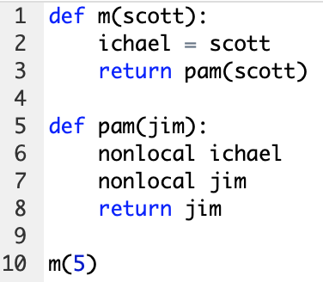

WWPD: The Office

Slide 69
Error: name 'jim' is parameter

Slide 70

Error: name 'jim' is parameter

Slide 71
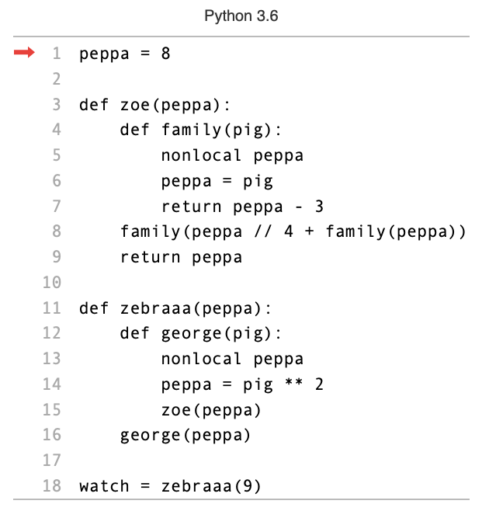

Environment
Diagram:
Peppa Pig

Slide 72

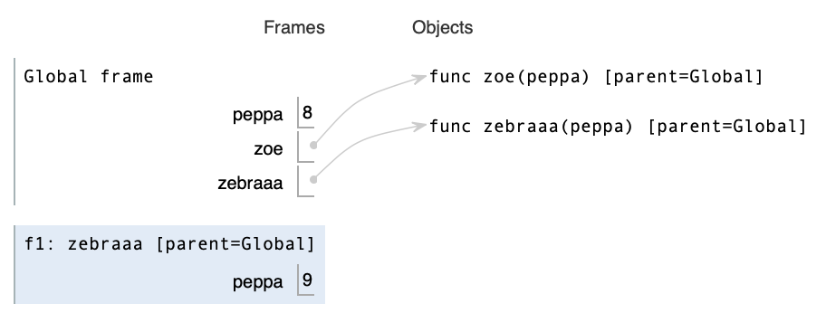
Environment Diagram:
Peppa Pig

Slide 73

Environment Diagram:
Peppa Pig

Slide 74
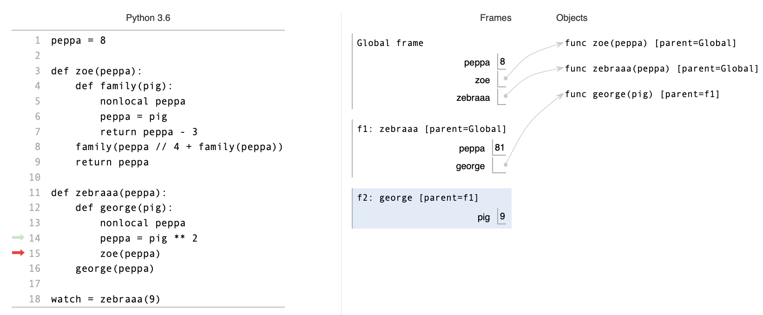
Environment Diagram: Peppa Pig

Slide 75
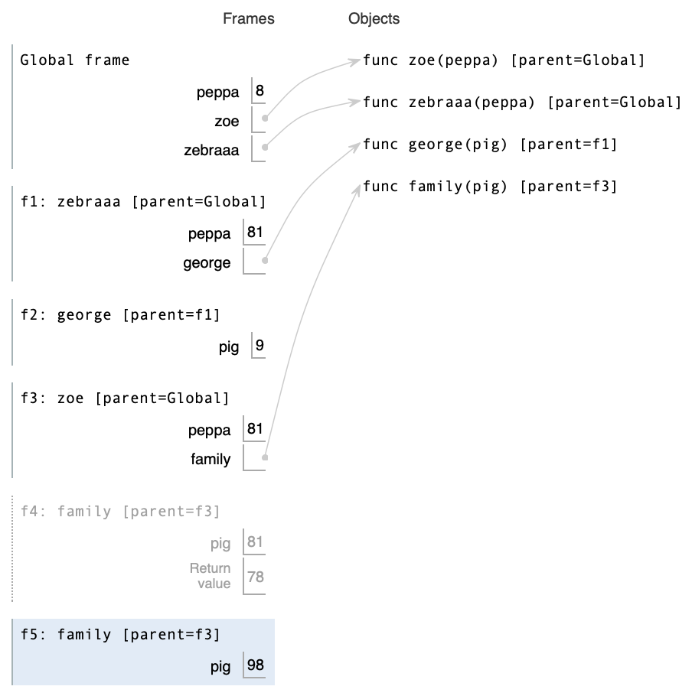
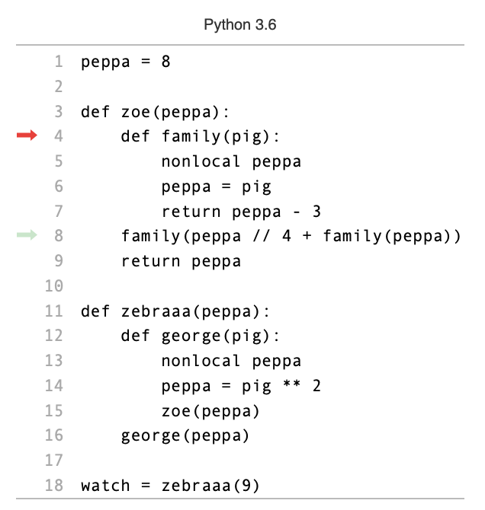
Environment Diagram:
Peppa Pig

Slide 76
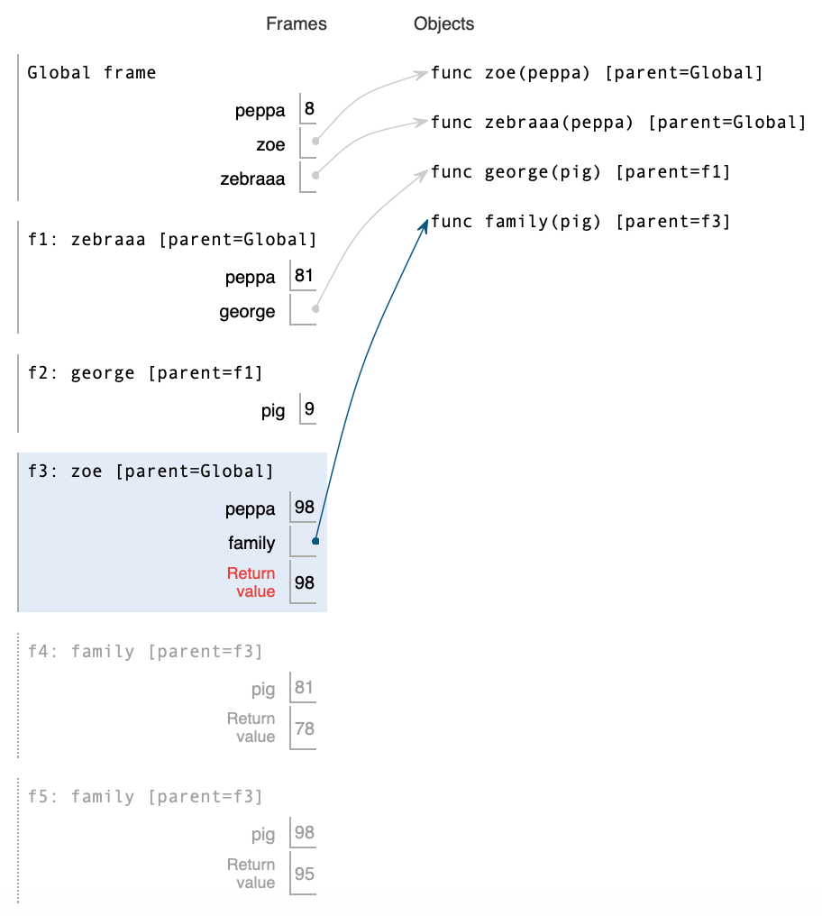
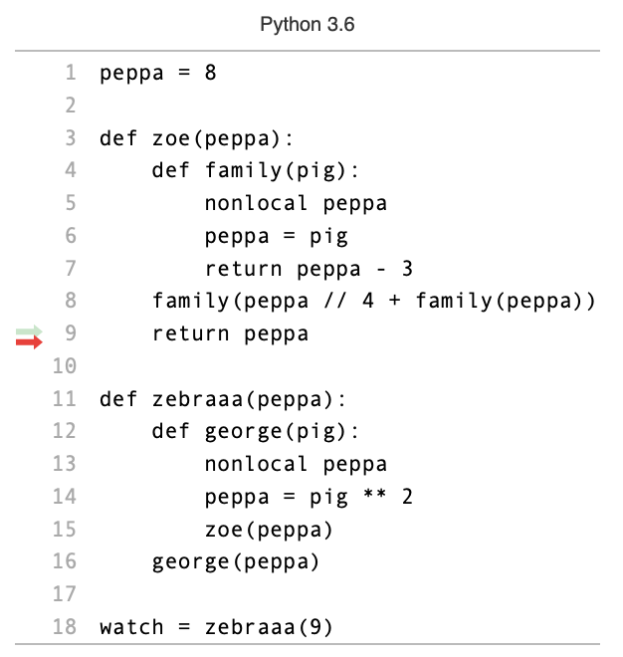

Environment Diagram:
Peppa Pig

Slide 77
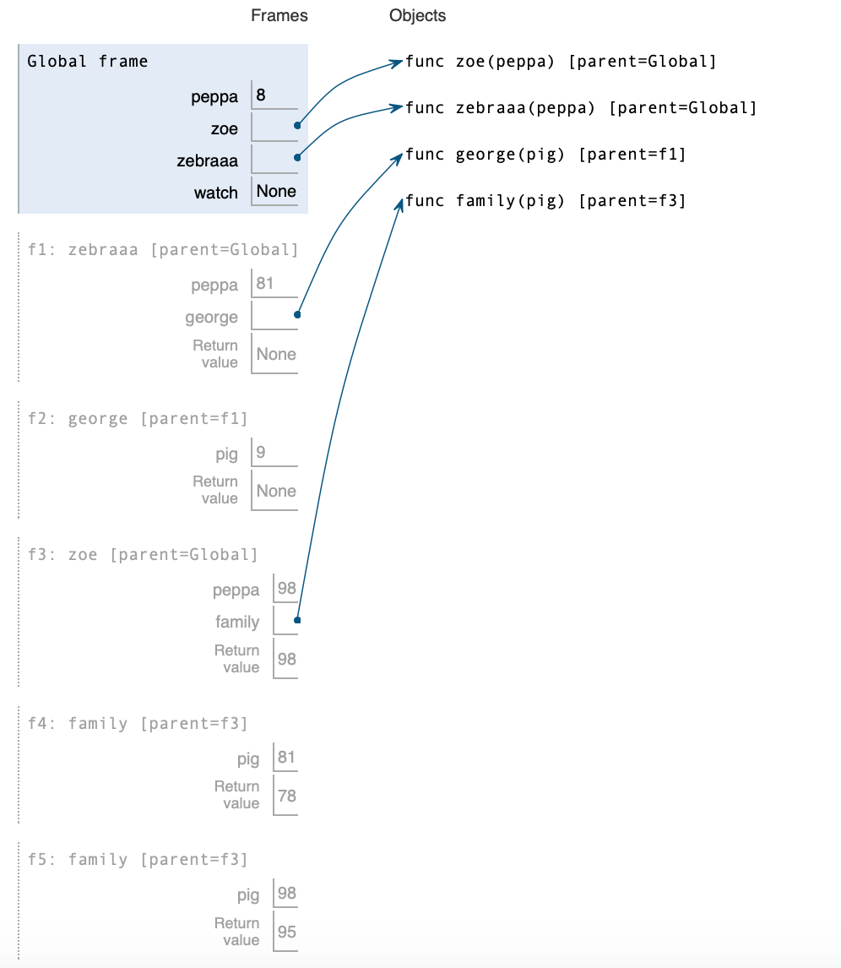
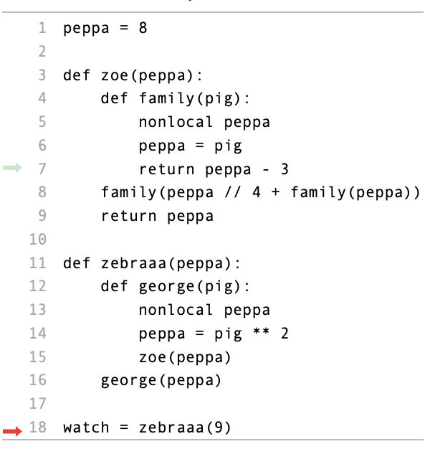
Environment Diagram:
Peppa Pig

Slide 78

Environment Diagram:
Peppa Pig

Slide 79
Orders of Growth: Big Picture
Main Idea: Understand how the function behaves as we increase the input size
How efficient is the code we’re writing?
How fast does it run for large values of n?
With each increase in input size, how much longer does our function take to run?

Slide 80
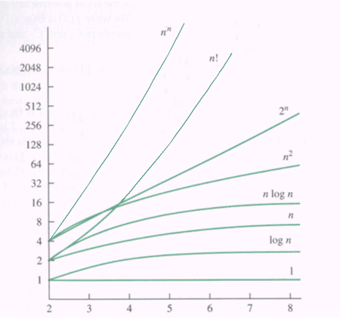
Examples of Common OOG
Θ(1) Constant growth
Θ(log n) Logarithmic growth
Θ(n) Linear growth
Θ(n²) Quadratic growth
Θ(b^{n}) Exponential growth
Time to Run
Input Size

Slide 81
Amount of Work
Type | Description
Constant - Θ(1) | Regardless of the size of the input, this function will take a constant amount of work.
Logarithmic – Θ(log(n))
Linear – Θ(n)
Quadratic– Θ(n²)
Exponential – Θ(b^{n})

Slide 82
Amount of Work
Type | Description
Constant - Θ(1) | Regardless of the size of the input, this function will take a constant amount of work.
Logarithmic – Θ(log(n)) | Multiplying n by a factor increments the amount of work done by the program.
Linear – Θ(n)
Quadratic– Θ(n²)
Exponential – Θ(b^{n})

Slide 83
Amount of Work
Type | Description
Constant - Θ(1) | Regardless of the size of the input, this function will take a constant amount of work.
Logarithmic – Θ(log(n)) | Multiplying n by a factor increments the amount of work done by the program.
Linear – Θ(n) | Increasing the size of the input by one will result in one additional unit of work.
Quadratic– Θ(n²)
Exponential – Θ(b^{n})

Slide 84
Amount of Work
Type | Description
Constant - Θ(1) | Regardless of the size of the input, this function will take a constant amount of work.
Logarithmic – Θ(log(n)) | Multiplying n by a factor increments the amount of work done by the program.
Linear – Θ(n) | Increasing the size of the input by one will result in one additional unit of work.
Quadratic– Θ(n²) | Increasing the size of the input by one will result in n additional units of work.
Exponential – Θ(b^{n})

Slide 85
Amount of Work
Type | Description
Constant - Θ(1) | Regardless of the size of the input, this function will take a constant amount of work.
Logarithmic – Θ(log(n)) | Multiplying n by a factor increments the amount of work done by the program.
Linear – Θ(n) | Increasing the size of the input by one will result in one additional unit of work.
Quadratic– Θ(n²) | Increasing the size of the input by one will result in n additional units of work.
Exponential – Θ(b^{n}) | Increasing the size of the input results in b times as many units of work at each step.

Slide 86
General Rules
Ignore lower order terms
Larger terms dominate the growth of a function, so we can ignore the smaller terms
N² + N → Θ(N²)

Slide 87
General Rules
Ignore lower order terms
Larger terms dominate the growth of a function, so we can ignore the smaller terms
N² + N → Θ(N²)
Ignore constants
Constants don’t affect the magnitude of the growth rate
4N → Θ(N)

Slide 88
General Rules
Ignore lower order terms
Larger terms dominate the growth of a function, so we can ignore the smaller terms
N² + N → Θ(N²)
Ignore constants
Constants don’t affect the magnitude of the growth rate
4N → Θ(N)
This applies to the base of logarithms that we are considering
log_{b}(N) → Θ(log(N)), for all b > 0

Slide 89
Things to Watch Out For
A function finishes execution after running a return statement
For-loops containing return statements may not continue iterating
The runtime for nested for-loops is not necessarily the product of the runtimes of each individual for-loop
Look carefully at the way variables are incremented
Do not jump to conclusions when deciding how many times the central code executes

Slide 90
Problem 1: Simple Θ bounds
Provide simple (i.e. no additive or multiplicative constants) Θ(.) bounds for the following functions:
8x⁵ + 3x³ + 4000x
log₂ x + log₃ x
1.1^{n} + 80n⁴

Slide 91
Problem 1: Runtime Analysis
Give a Θ(.) bound on the runtime of the following function, in terms of n. Assume both a and b are lists of length n.:
def convolve(a, b):
c = []
for i in range(n):
c.append(0)
for j in range(i):
c[i] += a[j] * b[i - j]

Slide 92
Problem 1: Runtime Analysis
Give a Θ(.) bound on the runtime of the following function, in terms of n. Assume both a and b are lists of length n.:
def convolve(a, b):
c = []
for i in range(n):
c.append(0)
for j in range(i):
c[i] += a[j] * b[i - j]
Θ(1)

Slide 93
Problem 1: Runtime Analysis
Give a Θ(.) bound on the runtime of the following function, in terms of n. Assume both a and b are lists of length n.:
def convolve(a, b):
c = []
for i in range(n):
c.append(0)
for j in range(i):
c[i] += a[j] * b[i - j]
Θ(i * 1)

Slide 94
Problem 1: Runtime Analysis
Give a Θ(.) bound on the runtime of the following function, in terms of n. Assume both a and b are lists of length n.:
def convolve(a, b):
c = []
for i in range(n):
c.append(0)
for j in range(i):
c[i] += a[j] * b[i - j]
Θ(n * i * 1)

Slide 95
Problem 1: Runtime Analysis
Give a Θ(.) bound on the runtime of the following function, in terms of n. Assume both a and b are lists of length n.:
def convolve(a, b):
c = []
for i in range(n):
c.append(0)
for j in range(i):
c[i] += a[j] * b[i - j]
The largest value that i will be is n, so we can simplify to n²
Θ(n²)
Notes:
The amount of work is proportional to 1 + 2 + … + n, which can be modeled as a triangle with length and height n. Hence, the work is proportional to (1/2)N^2, which is in Θ(N^2)!

Slide 96
Problem 2: More analysis
Give Θ(.) bounds in terms of n, the length of lst, for the runtime of the function, and for the number of nodes in the tree produced:
def sum_tree(lst):
if (len(lst) == 1):
return Tree(lst[0])
label = sum(lst)
child_label = lst.pop()
result = Tree(label, [Tree(child_label), sum_tree(lst)])
return result

Slide 97
Problem 2: More analysis
Give Θ(.) bounds in terms of n, the length of lst, for the runtime of the function, and for the number of nodes in the tree produced:
# of nodes: Θ(n)
def sum_tree(lst):
if (len(lst) == 1):
return Tree(lst[0])
label = sum(lst)
child_label = lst.pop()
result = Tree(label, [Tree(child_label), sum_tree(lst)])
return result
For each element in lst, we add 2 nodes to our tree

Slide 98
Problem 2: More analysis
Give Θ(.) bounds in terms of n, the length of lst, for the runtime of the function, and for the number of nodes in the tree produced:
To find the sum of a list we have to iterate across each element!
def sum_tree(lst):
if (len(lst) == 1):
return Tree(lst[0])
label = sum(lst)
child_label = lst.pop()
result = Tree(label, [Tree(child_label), sum_tree(lst)])
return result
Θ(n)

Slide 99
Problem 2: More analysis
Give Θ(.) bounds in terms of n, the length of lst, for the runtime of the function, and for the number of nodes in the tree produced:
Runtime: Θ(n²)
def sum_tree(lst):
if (len(lst) == 1):
return Tree(lst[0])
label = sum(lst)
child_label = lst.pop()
result = Tree(label, [Tree(child_label), sum_tree(lst)])
return result
We know we’re creating n nodes in the tree, and to create each node we have to do n work for each one to calculate the label
Notes:
The runtime looks like the triangle from the previous problem!

Slide 100
Problem 3: Even more analysis
Give a Θ(.) bound in terms of n, for the runtime of the function
def mystery(n):
total = 0
for i in range(n // 2):
j = 1
while j < n:
j *= 2
total += i * j
return total

Slide 101
Problem 3: Even more analysis
Give a Θ(.) bound in terms of n, for the runtime of the function
def mystery(n):
total = 0
for i in range(n // 2):
j = 1
while j < n:
j *= 2
total += i * j
return total
Θ(logn)

Slide 102
Problem 3: Even more analysis
Give a Θ(.) bound in terms of n, for the runtime of the function
def mystery(n):
total = 0
for i in range(n // 2):
j = 1
while j < n:
j *= 2
total += i * j
return total
Θ(n) iterations * Θ(logn) work/iteration

Slide 103
Problem 3: Even more analysis
Give a Θ(.) bound in terms of n, for the runtime of the function
def mystery(n):
total = 0
for i in range(n // 2):
j = 1
while j < n:
j *= 2
total += i * j
return total
Θ(n) iterations * Θ(logn) work per iteration
Runtime: Θ(nlogn)

Slide 104
OBJECT ORIENTED PROGRAMMING (OOP)

Slide 105
What is Object-Oriented Programming?
It is a programming paradigm that allows us to
Treat data as objects like in real life
Use classes as a form of abstraction combining data and functionality
Create multiple instances of objects
Reduce redundancy

Slide 106
Terminology
An object or instance works like a type of variable you can create yourself.
A class is a block of code that defines the properties of an object .
Classes contain attributes and functions that belong to two categories:
Instance/object attributes: The value stored (in a variable) or the behavior (of a function) differs depending on the object created.
Class attributes: The value stored (in a variable) or the behavior (of a function) is the same no matter what object is used.
A method is a function defined in a class.
After you write a class, you can create objects from it.

Slide 107
Inheritance
A class can extend another class, meaning that it inherits (has access to) all attributes and methods of that class.
The subclass shares (not copies!) attributes from the super/parent class.
The subclass can override inherited attributes/methods
If not present in the subclass, look up attributes/methods in the parent class.

Slide 108
Structure of a Class
class <class name>(<parent class names>):
<class attribute> = <value>
def __init__(self, value1, value2,...):
self.<instance attribute> = <value>
…
def <function name>(self, <parameters>):
…
def <function name>(<parameters>):
…
Class header
Set class attributes here
Constructor for objects
Set instance attributes here
Instance method
Class method

Slide 109
Creating an Object
Syntax: <name> = <class name>(<parameters>)
The line above calls the class’s constructor.
You must use as many parameters as the constructor takes in, excluding self.

Slide 110
Dot Notation
It is a way to get the value of an attribute or call a method in a class.
Syntax: <class or object name>.<attribute or method>
If you use an object name ():
Do not specify the self parameter if you’re calling an instance method.
If it is not an instance attribute/method, the class attribute/method is used.
If you use a class name:
Use an object as the self parameter if you call an instance method.
You cannot access an instance attribute.

Slide 111
Problem 1
class Pet:
color = “Red”
name = " Clifford "
def __init__(self, num_legs):
print ("A new pet!")
self.num_legs = num_legs
def sleep ():
print (" Zzzz ")
class RubberDuck (Pet):
color = "Yellow"
def __init__ (self):
self.voice = print("Quack")
Pet.name = "Daisy"
name = "Daffy"
self.num_legs = Pet(0).num_legs
def debug (self):
print ("What is wrong?")
return self.voice
Expression | Interactive Output
p = Pet(4) | A new pet!
p.self.name | ‘Error: Attribute not found’
p.sleep() | ‘Error: Gave 1 Arg, expected 0’
q = RubberDuck() | Quack A new pet!
p.name + q.name | ‘DaisyDaisy’
print(q.debug()) | What is wrong? None

Slide 112
Problem 2
class Worker:
greeting = “Sir”
def __init__(self):
self.elf = Worker
def work (self):
return self.greeting + ‘, I work’
def __repr__ (self):
return Bourgeoisie.greeting
class Bourgeoisie (Worker):
greeting = ‘Peon’
def work (self):
print (Worker.work(self))
return ‘My job is to gather wealth’
jack = Worker()
john = Bourgeoisie ()
jack . greeting = ’Maam ’
Expression | Interactive Output
Worker().work() | ‘Sir, I work’
jack | Peon
jack.work() | ’Maam, I work’
john.work()[10:] | Peon, I work ’to gather wealth’
Proletariat().work(john) | Comrade Peon, I work Peon
john.elf.work(john) | ’Comrade Peon, I work’
class Proletariat (Worker):
greeting = ‘Comrade’
def work (self, other):
other.greeting = self.greeting + ‘ ‘ + other.greeting
other.work
return other

Slide 113
Linked Lists

Slide 114
Elements of a Linked List
What Are linked lists?
Another way to represent a sequence of ordered values (just like regular lists)
Series of “linked” nodes. Each node has a first and a rest attribute
first represents the value (information), and rest is just an instance of a linked list
Construction:
lnk = Link(0, Link(1, Link(2, Link(Link(3)))))

Slide 115
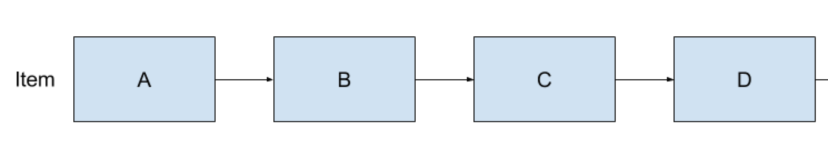
Linked List Tips
Linked lists can be a bit tricky when you’re playing around with their pointers (lst.next.next.next.next.next.next ???)
Make sure to draw things out!
It helps make things a little clearer
Keep track where your pointers are and don’t remove a pointer to something without creating a temp one.
vs
Link(‘A’, Link(‘B’, Link(‘C’, Link(‘D’))))

Slide 116
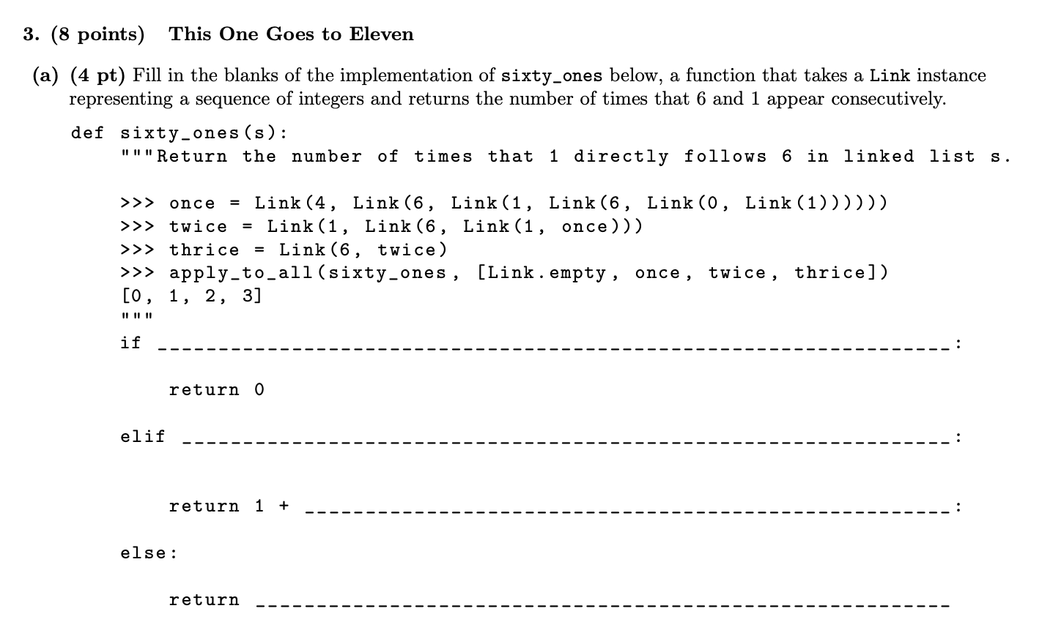
Problem 1
s is Link.empty or s.rest is Link.empty
s.first == 6 and s.rest.first == 1
sixty_ones(s.rest.rest)
sixty_ones(s.rest)
Notes:
To approach working on the base case, we want to think about where our problem would stop! We want to find the number of consecutive sixes and ones. If a linked list is empty or only one item long (s.rest is Link.empty) then we should stop and return 0.
The second check would be to check if the contents of the list is 6 then 1. So if s.first == 6 and then s.rest.first == 1, then we have 61 in order in the list. That means we have one success! We return 1, then shift over in the list with sixty_ones(s.rest.rest)
The last case is if there’s more elements in the list but it’s not a 61, so we should just move to the next item in the list and call sixty_ones(s.rest)

Slide 117
Problem 2
def double(L):
""" Returns a list in which each item in L appears
twice in sequence. It is non - destructive.
>>> Q = Link (3 , Link (4 , Link (1)))
>>> double(Q)
Link (3 , Link (3 , Link (4 , Link (4 , Link (1 , Link (1))))))
>>> Q
Link (3 , Link (4 , Link (1)))
>>> double1( Link . empty )
()
"""
Notes:
http://inst.eecs.berkeley.edu/~cs61a/sp16/assets/pdfs/61a-sp16-mt2.pdf#page=7
http://inst.eecs.berkeley.edu/~cs61a/sp16/assets/pdfs/61a-sp16-mt2-solution.pdf#page=7
First problem

Slide 118
Problem 2
def double(L):
result = ________________________
last = None
while L is not Link.empty:
if last is None:
__________________________
__________________________
else:
__________________________
__________________________
______________________________
return result
Notes:
http://inst.eecs.berkeley.edu/~cs61a/sp16/assets/pdfs/61a-sp16-mt2.pdf#page=7
http://inst.eecs.berkeley.edu/~cs61a/sp16/assets/pdfs/61a-sp16-mt2-solution.pdf#page=7
First problem

Slide 119
Problem 2
def double(L):
result = Link.empty
last = None
while L is not Link.empty:
if last is None:
result = Link(L.first, Link(L.first))
last = result.rest
else:
last.rest = Link(L.first, Link(L.first))
last = last.rest.rest
L = L.rest
return result
Notes:
http://inst.eecs.berkeley.edu/~cs61a/sp16/assets/pdfs/61a-sp16-mt2.pdf#page=7
http://inst.eecs.berkeley.edu/~cs61a/sp16/assets/pdfs/61a-sp16-mt2-solution.pdf#page=7
First problem

Slide 120
GOOD LUCK ON THE EXAM! WE BELIEVE IN YOU!
Remember to take care of yourselves :^)
Stay hydrated, eat good food, get enough sleep!
Notes:
Note: add some cat pics

